Slide 1
Cox Operational Reporting

Slide 2
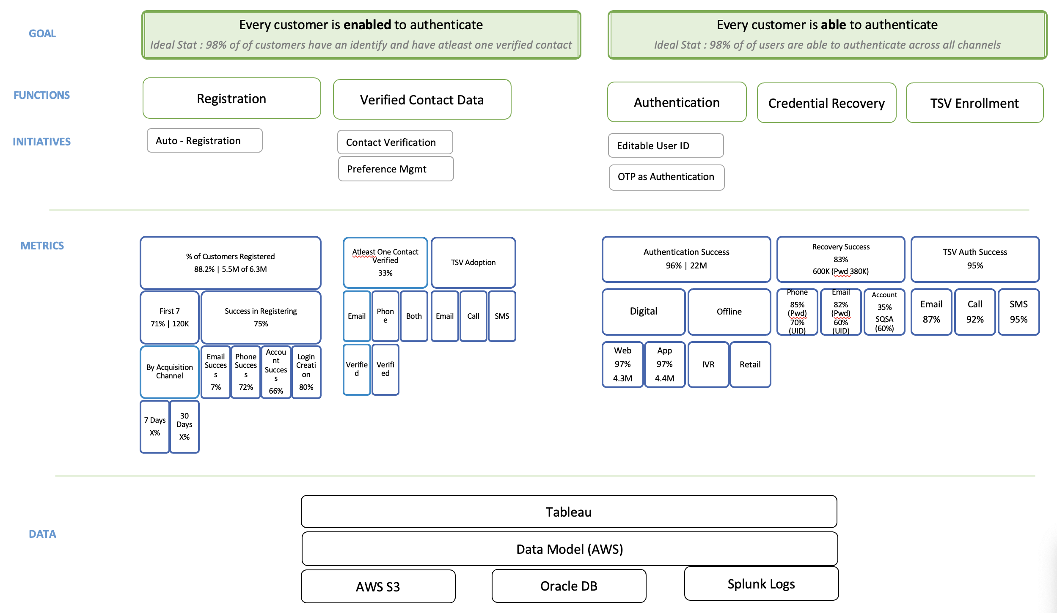
CIAM - Functions, Initiatives and Metrics

Slide 3
Internal Org
Eric Pace
(Digital)
Matt Earnest
Elliot Schwartz
AI & Analytics
Richard Brown
eClerx
Praveen
Eric owns all digital asserts for cox communications for residential and commercial business
The AI& Analytics org manages AI initiatives and end to end digital analytics for Eric’s org including Sales and Self-service
Matt owns all self-service functions (current customer) including CIAM
Elliot owns end to end CIAM Program in partnership with Technology & Security
Richard owns end to end digital analytics for Eric’s org
Praveen manages analytics for all self-service functions for Matt’s org

Slide 4
Projects in Pipeline
Operational Health Scorecards (Digital Health and Behavior)
Migrate excel based ‘residential mobile app’ scorecard to tableau
New scorecard for ‘residential web’ in tableau
New scorecard for ‘commercial web’ in tableau
Campaign Performance Scorecard
Build data layer for reporting and modelling purposes
Adobe data
CRM data

